Slide 1
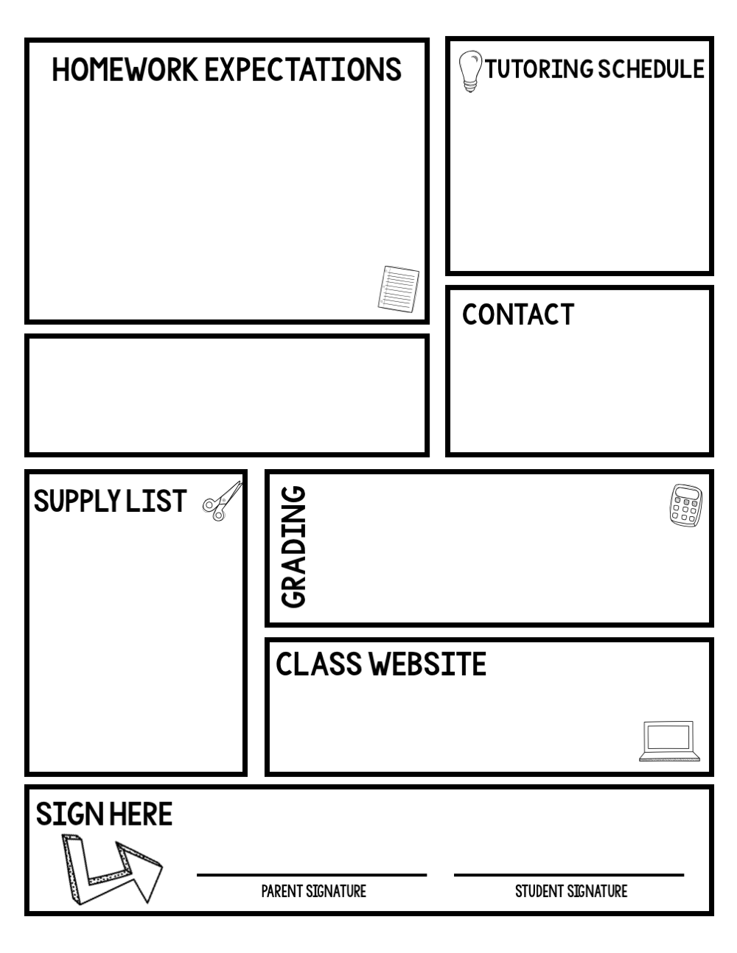
Homework is expected to be completed and turned in at the beginning of the class period.
Students who are absent have two days for each day absent to make up work.
Students with incomplete or missing homework will be placed on the ICU (Intensive Care Unit) List.
Failure to turn in homework will require students to attend Wednesday School from 2:15-3:00 pm.
I am in the classroom by 8am (If you want to meet earlier arrange a time with me)
Or visit with me after school
SV Middle School
Language Arts
email:
kari.eliason@k12.sd.us
GRADING SCALE A- 100-93
B- 92-85
C- 84-77
D- 76-70 F- 69 & Below
Bring to each class:
Folder
Paper/notebook
Pencil(s)
Colored pen/pencil (not black or blue)
Independent reading book
Planner
LA book/novel (when applicable)
mseliason.weebly.com
Date
©Maneuvering the Middle LLC, 2018

